Slide 1
W-1 Leon Creek: Hwy 151 to Hwy 90
Upper Segment
Chris Mason, PE
Project Engineer, SAWS
Roxanne L. Lockhart
Contract Administrator, SAWS
Marisol V. Robles
SMWVB Program Manager, SAWS
Jason Diamond, PE
Project Engineer of Record, Pape-Dawson Engineers
Joseph Ortega, PE
Project Engineer, Pape-Dawson Engineers
Non-Mandatory Pre-Proposal Meeting
August 31, 2020 at 10:00 AM

Slide 2
WebEx Meeting Information
With the switch to an online WebEx meeting, attendees can:
  Access the presentation thru the WebEx link to follow along real-time
  Access via phone and follow along with the PowerPoint posted on the SAWS web at: https://apps.saws.org/business_center/contractsol/Drill.cfm?id=3865&View=Yes
  Use the chat feature to ask questions, or
  Ask questions through email to roxanne.lockhart@saws.org
    SAWS will read questions aloud
Please mute your devices during the meeting

Slide 3
Oral Statements
Oral statements or discussion during the pre-proposal meeting will not be binding, nor will it change or affect the terms or conditions within the Plans and Specifications for this Project. Changes, if any, will be addressed only via an Addendum.

Slide 4
Meeting Agenda
Project Overview
Contract Requirements
Key Project Information
Evaluation Process
Required Experience
Evaluation Criteria
Proposal Packet Preparation
SMWB
Additional and Communication Reminders
Key Dates
Contract Background
  Supplemental Conditions
  Special Conditions
  Special Provisions
  Special Specifications
Questions

Slide 5
Project Overview
The project will replace and upsize approximately 1.5 miles of 42-inch gravity sewer main with 7,740 LF 84-inch Fiberglass Reinforced Pipe (FRP) gravity sanitary sewer main, and includes various diameter tie-ins, bypass pumping, pavement repairs, and traffic control.

Slide 6
Key Project Information
Contract duration is 563 calendar days
Construction cost estimate is approximately $17.3 M
Procured under Chapter 2269 of Texas Government Code as a Request for Competitive Sealed Proposals (RFCSP)
EPA Consent Decree project, which requires additional reporting and retention of document (see Special Conditions)

Slide 7
Contract Requirements
  Prevailing Wage Rate and Labor Standards – Section 2.10 of the General Conditions
  Certified payroll to be submitted on weekly basis
  Wage decisions are included within the specifications
  Contractors to utilize LCP Tracker
  Site visits are random and unannounced
  Interviews will be conducted and will be private & confidential
  Payroll records are subject to review
  All apprenticeship programs will need to be approved by Department of Labor prior to starting
  Contractors are responsible for sub-contractor payroll
  Late payrolls delay contractor payments from SAWS

Slide 8
Contract Requirements
Insurance – Found in Section 5.7 of the General Conditions
  Include General Liability for Construction, Pollution Liability, Excess Liability and Installation Floater (in lieu of Builder’s Risk).
  Selected contractor must be compliant with all other contracts in order for SAWS to award the contract.
  SAWS will request insurance certificate prior to Board award to ensure insurance compliance and expedite execution of the contract.
  Insurance must be compliant prior to executing the contract.

Slide 9
Evaluation Process
  Technical Evaluation Committee (TEC) will score the proposals based on the evaluation criteria published in the Supplementary Instructions to Respondents to determine the Respondent who can provide the best value to SAWS
  Price will be calculated (lowest price receives the highest points) and added to final scores
  SMWB will be added to final scores
  Selection Evaluation Committee reviews final scores
  Negotiations, if any
  Board award

Slide 10
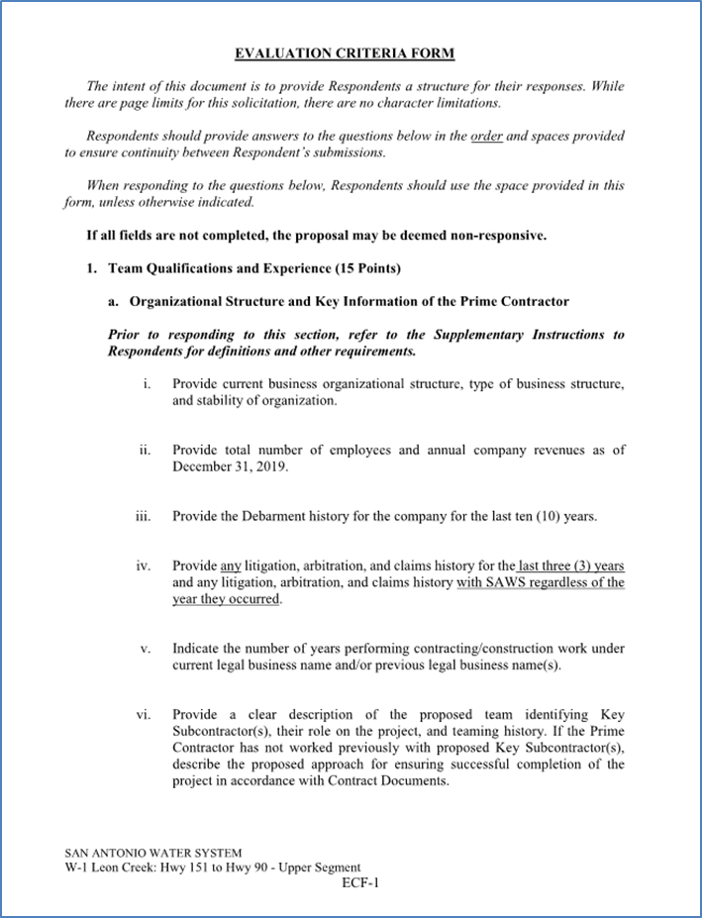
Proposal Packet Preparation
Request FTP Site for proposal upload
Proposal page limits do apply ; see Required Documents Matrix
Review Instructions to Respondents and Supplementary Instructions to Respondents
Utilize the Proposal Response Checklist
  3 files required for electronic submittal
  Follow file naming convention
Utilize Provided Evaluation Criteria Forms
  Fillable form in Word is provided on SAWS website

Slide 11
Proposal Packet Preparation
Required Experience
  Entire proposal should create a clear picture of Project Team experience and capabilities (Org chart, projects, and resumes for Key Personnel and Key Subcontractors)
  Show large diameter wastewater pipe installation is primary business focus and service, such services successful for at a minimum of 5 continuous years.
Thoroughly review scope and ensure project examples and key personnel resumes clearly show similar experience
Thoroughly review evaluation criteria and respond with all required information to maximize points
Avoid “boilerplate” responses

Slide 12
Proposal Packet Preparation
Verify contact information for all project references, if SAWS is not able to contact reference, points may be deducted or proposal deemed non-responsive
Ensure required documents are submitted and signed (i.e. Respondent Questionnaire, CIQ, etc.)
Price Proposal
  Acknowledge Addendums on Proposal Signature Page
  Verify all formula extensions and mob and prep of ROW percentages

Slide 13
Evaluation Criteria
Criteria | Weight | Pg. No.
Team Qualifications and Experience | 15% | SIR-3
Quality, Reputation, and Ability to Deliver Projects on Schedule and within Budget | 25% | SIR-5
Project Approach including Delivery Schedule | 15% | SIR-8
Price Proposal | 35% | SIR-9
Small, Minority, and Woman-owned Business Participation | 10% | SIR-10
TOTAL | 100%

Slide 14
Evaluation Criteria
Team Qualifications and Experience (15 points)
Organizational Structure and Key Information on Prime Contractor
  Company information (structure, debarment history, # of employees, years of construction work, etc.)
  Organizational Chart with Key Personnel with percentage of availability, clear description of roles and responsibilities (Prime and Key Subs)
    Team history or approach if no prior experience to ensure successful completion of project
  Contractor CANNOT change Key Personnel identified in proposal without written request to SAWS and SAWS written approval
  Financial statement within the last 12 months by independent CPA

Slide 15
Evaluation Criteria
Team Qualifications and Experience
Qualifications and Experience of Key Personnel Proposed for Project
  Resumes of Key Personnel on 8 ½ x 11” one per person, not to exceed one (1) page as identified on the Org Chart
    Professional experience, education, role, descriptions of capabilities, etc.
    List of all other active projects team member assigned, percentage, date of completion of work
✓ Key Personnel include PM, CM, QA/QC Lead, Project Scheduler, Project Superintendent, Open Cut Superintendent, Tunneling Superintendent
✓Key Subcontractor roles could include tunneling, hand mining, large diameter open cut, sewer bypass.

Slide 16
Evaluation Criteria
Quality, Reputation and Ability to Deliver Projects on Schedule and within Budget (25 points)
Prime Contractor Performance on Similar Projects in the past 10 years
  List and describe 5 completed projects of similar size, scope, and complexity within the last 10 years
  Owner reference contact information should be valid and recently verified
    If valid contact information is not provided, score or proposal may be negatively impacted
  2 of the 5 projects listed must have been performed by the proposed Key Personnel
  If SAWS experience, one project of similar size, scope, and complexity must be included
  The Respondent shall provide information for all current and recently completed large diameter pipeline projects performed in the last five (5) years for all Utility Owners in Texas

Slide 17
Evaluation Criteria
Quality, Reputation and Ability to Deliver Projects on Schedule and within Budget
Key Subcontractor(s) Performance on Similar Projects in the Last 10 years
  Provide list of 2 projects that Key Subcontractors Project Manager and/or Superintendent participated in of similar size, scope, and complexity
  If Prime plans to self-perform and has no Key Subcontractors, provide a list of 2 additional projects
    Key Personnel shall have participated in at least 1 of the 2 projects

Slide 18
Evaluation Criteria
Project Approach including Delivery Schedule (15 points)
Project Approach
  Narrative of Project Approach to complete project, including key milestones, critical path items, phases and/or sequencing, permits, etc.
  Availability of equipment and facilities
  Describe approach for coordination with key stakeholders
  Provide innovative ideas for cost savings (due to a change in scope)
    Opportunity to provide innovation (per TX Gov’t Code 2269)
    Providing initial price, based on provided Contract Documents
    Negotiation can/will take place with best value Contractor
  Quality Management Plan including subcontractor oversight, QA/QC, etc.

Slide 19
Evaluation Criteria
Project Approach including Delivery Schedule
Project Schedule, Procurement of Long-lead Items, & Unforeseen Conditions
  Critical path method (CPM) schedule Primavera or Microsoft project - Assume NTP of January 4, 2021.
  Describe the approach to procure long-lead items
  List and describe prior instances of unforeseen conditions
  Approach for mitigating and managing unforeseen conditions on this project

Slide 20
Evaluation Criteria
Safety Information for Prime Contractor and Key Subcontractor(s)
Records showing Total Recordable Incident Rate (TRIR) past 5 years
Provide records showing the company’s Experience Modification Rate (EMR) past 3 years
List fatalities in company’s safety history for Prime Contractor and Key Subcontractor(s)

Slide 21
Evaluation Criteria
Price (35 points)
Lowest total price will receive 35 points.
Remaining proposals will receive points based on comparison to the lowest price proposal.
Small Minority, and Woman-owned Business (10 points)
Up to 10 points may be earned for SMWB participation as indicated on SIR-10 and SIR-11.

Slide 22
Evaluation Criteria
Industry | Aspirational SMWB Goal
Construction | 20%
The aspirational SMWB goal is expressed as 20% of your total bid price.

Slide 23
SMWVB Scoring
Proposed SAWS Construction Alternative Delivery Method SMWB Scoring:
All respondents may earn the maximum number of SMWB points (10 points). Firms may use any combination of points below when attempting to meet the SMWB goals. Self-performance and subcontracting may be used to achieve the aspirational goals and earn points. SMWB prime contractors and/or subcontractors must be certified by the South Central Texas Regional Certification Agency, and must have a local presence in the San Antonio Metropolitan Statistical Area in order to be eligible for SMWB points.
1. M/WBE Scoring Method: 10 Points (By percentage) 20.00% M/WBE Goal
• MBE Participation Percentage between 1% and 4.99%: 1 Point
• MBE Participation Percentage between 5% and 9.99%: 2 Points
• MBE Participation Percentage between 10% and 14.99%: 4 Points
• MBE Participation Percentage between 15% and 16.99%: 5 Points
• MBE Participation Percentage between 17% and 19.99%: 8 Points
• MBE Participation Percentage meeting or exceeding 20.00%: 10 Points
2. SBE (Non-M/WBE) Scoring Method: 5 Points (By percentage) 5% SBE Goal
• SBE Participation Percentage between 1% and 1.99%: 1 Point
• SBE Participation Percentage between 2% and 2.99%: 2 Points
• SBE Participation Percentage between 3% and 3.99%: 3 Points
• SBE Participation Percentage between 4% and 4.99%: 4 Points
• SBE Participation Percentage meeting or exceeding 5.00%: 5 Points

Slide 24
Accepted SMWVB Certification Agency
South Central Texas Regional Certification Agency
(Includes the Texas Historically Underutilized Business “HUB” Program)
Minimum Qualifications for SMWVB recognition:
SBE-Certified (even MBEs and WBEs)
Local office or local equipment yard

Slide 25
Good Faith Effort Plan (GFEP) FAQs
Q: Is the 20% SMWVB goal mandatory?
A: No, but we ask prime contractors to do their best with good faith outreach efforts. If the goal is not met, proof of outreach efforts is required with the submittal.
Q: What if I am having trouble finding SMWVB subcontractors?
A: Please email the SMWVB Program Manager with the scopes of work you are seeking. You will receive lists of local SMWVB-certified firms to contact.
Q: What if my business is SMWVB-certified? Do I need to find SMWVB subs?
A: If your firm is SMWVB-certified, you will most likely meet the goal. However, the GFEP is a required document, and a good faith outreach effort is still necessary.
Q: Do I need to include all my subcontractors in the GFEP or just those that qualify towards the
SMWVB goal?
A: All subcontractors need to be included in the GFEP, even those that may not count towards the SMWVB goal.
Q: What if I have questions about the GFEP?
A: Please contact the SMWVB Program Manager at 210-233-3420, or at Marisol.Robles@saws.org . GFEP questions can be asked at any time before the submittal is due.
Notes:
SMWB

Slide 26
Post Award: Subcontractor Payment & Utilization Reporting (S.P.U.R.) System
1. Subcontractor & Supplier Payment Tracking
2. Subcontractor and Supplier Additions or Substitutions
3. LCP Tracker
4. Must be Current and Accurate before Retainage is released https://saws.smwbe.com

Slide 27
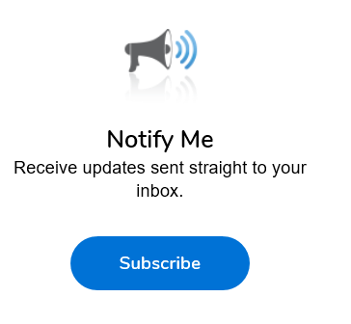
Additional Reminders
Register with Vendor Registration Program on the SAWS website at www.saws.org to ensure access to the latest information.
To receive updates on specific projects, registered vendors should subscribe to the project by selecting the project, and clicking ‘Subscribe’ under the Notify Me box.
Notes:
Contracting

Slide 28
Communication Reminders
There shall not be any communication with the following during the Proposal period:
  Design Engineer (Pape-Dawson)
  SAWS Project Manager or Project Engineer
  Any other SAWS staff
  City Council member or staff
  SAWS Board of Trustees
This includes phone calls, emails, letters, or any direct or indirect discussion of the Proposal

Slide 29
Key Dates
August 31, 2020 Non-Mandatory Pre-Proposal Meeting
Sep. 9, 2020 by 2:00 PM Questions Due
Sept. 16, 2020 by 2:00 PM Addendum Posted to SAWS Website
October 2, 2020 by 2:00 PM Last chance to request FTP Site
October 5, 2020 by 2:00 PM Proposals Due
October 2020 Proposals Evaluated
Oct./Nov. 2020 Selected Contractor Notified
December 8, 2020 SAWS Board Approval and Award
January 4, 2021 NTP Issued
Notes:
Please note that the last chance to request a secure FTP Site is Oct. 2, 2020 at 2pm. This FTP site will be required to upload proposals…

Slide 30
Submission Due Date
Proposals due no later than 2:00 PM CDT October 5, 2020
Electronic Proposals Only
Follow specific electronic proposal delivery instructions:
  Request the FTP Site for Upload no later than October 2, 2020 at 2:00 PM
  Follow naming convention provided in the Respondent Proposal Checklist for all 3 files
  Late responses will not be accepted and will be not be opened
  A WebEx proposal opening meeting will be held October 5, 2020 at 2:00 PM
SAWS continues to monitor and adhere to the current COVID-19 guidelines and may modify the proposal submission instructions.
  If so, this would be provided via Addendum no later than September 16, 2020.

Slide 31
Contract Background
Submittals can be submitted as soon as receiving notification of contract award after CPMS training (if necessary) has been completed and CPMS record is ready
Prior to commencing work, contractor must submit and receive approval of the following:
  Construction Schedule
  Pre-construction video
  Lease agreements
There will be one pre-construction meeting
Contractor must submit a Work Progress Schedule within 10 days of NTP and monthly thereafter

Slide 32
Contract Background
Contractor to follow requirements identified in corresponding permits or agreements.
  City of San Antonio Tree Permit
  City of San Antonio Floodplain Development Permit
  City of San Antonio Right-of-Way
  Storm Water Pollution Prevention Plan (SWPPP)
Changes in field that are cited by the Agency’s Inspector will require concurrence and approval from the SAWS Inspector first.
If contractor would like to work weekends or extended hours, notification is required 48 hours in advance to SAWS Construction and Inspections. Requests should be send to constworkreq@saws.org.

Slide 33
Contract Background
All RFIs, RFPs, submittals, and any other items related to construction must be uploaded and processed via CPMS.
No work can be performed by the Contractor unless the cost for that line item is on the contract.
All traffic control plans must be submitted to and approved by CoSA as applicable.
Change orders, if any, will be based on negotiated prices if items are not in the price proposal.
  Negotiated using RS Means

Slide 34
Contract Requirements
Supplemental Conditions
Liquidated damages (LDs) for final completion extending beyond contract time will be assessed at a rate of:
$ 1,850.00 per Day
ID Key Personnel, to be issued in Addendum 1
Baseline Schedule, to be issued in Addendum 1

Slide 35
Contract Requirements
Special Provisions
Item 100 – Mobilization: Establishes Intermediate Demobilization and Remobilization bid item if elected by SAWS, including definition of related temporary bypass pumping activities during SAWS-authorized demobilizations.
Item 864 – Bypass Pumping, large Diameter Sanitary Sewers: Establishes extended Bypass Pumping equipment rental, fuel, and watch payment items if needed in association with SAWS-approved intermediate demobilization.

Slide 36
Contract Requirements
Special Provisions and Special Specifications
SP 848 & SP 857 – Payment for installation of pipe (LF) and separate pay item for testing (LS).
SP 852 & SP 853 – Payment for installation of manholes (EA) and separate pay item for testing (LS).
SP 864-S2 – Bypass Pumping – Large Diameter Sanitary Sewers
SS 1050 Survey Controls - includes additional survey requirements

Slide 37
Project Overview
7,740 LF 84-inch Fiberglass Reinforced Pipe (FRP) gravity sanitary sewer main installation
  6,544 LF open-cut at depths up to 35 feet deep
  1,196 LF of tunneling including TXDOT ROW crossing at Hwy 151
  Installation along and crossing Leon Creek, within the 100-year floodplain
Unique Project Challenges
  Limited project access
  Existing WL and RWL relocates
  Large diameter bypass (70+ mgd)

Slide 38
Project Overview
Pipeline installation located next to and crossing Leon Creek.
  See Supplemental Spec. 2140 for Control of Ground and Surface Water
Close Coordination with several key stakeholders including but not limited to: SAWS for water main adjustments, Texas Department of Transportation (TXDOT), City of San Antonio (COSA) – Transportation and Capital Improvements Department, COSA Arborist, CPS Energy, private property owners, and business owners.
Notes:
SAWS PE presents

Slide 39
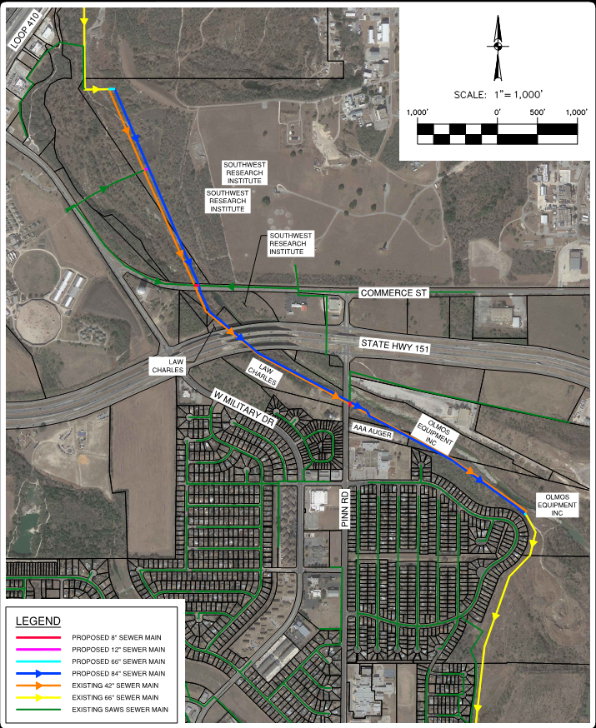
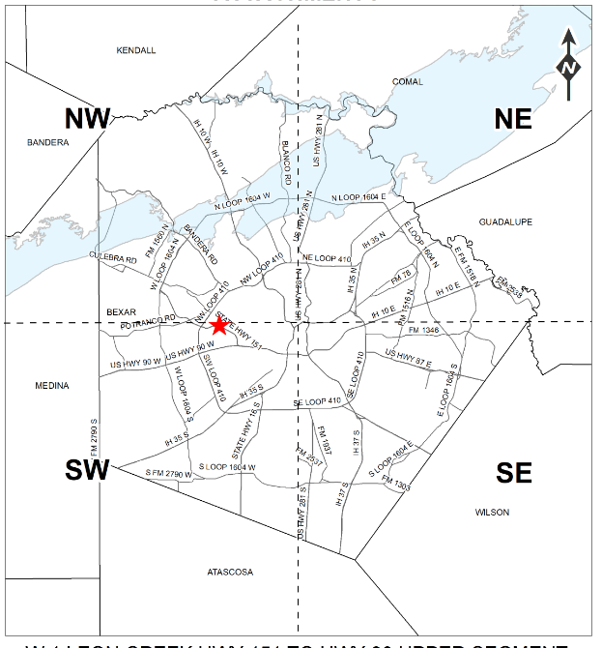
Project Location
Notes:
The project will replace and upsize approximately 1.5 miles of 42-inch gravity sewer main with 7,740 LF 84-inch Fiberglass Reinforced Pipe (FRP) gravity sanitary sewer main, and includes various diameter tie-ins, bypass pumping, pavement repairs, and traffic control.
Unique Project Challenges
EPA Consent Decree
Installation along and crossing Leon Creek, within the 100-year floodplain.
Limited project access
Multiple tunneling segments
Existing WL and RWL relocates
Large diameter bypass (70+ mgd)

Slide 40
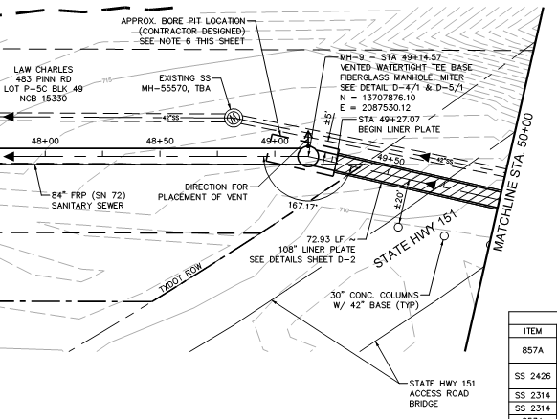
Tunnel Proximity to Existing 42” Sewer Main
Contractor shall protect existing 42” sanitary sewer during construction of proposed sewer main
Contractor needs to adequately shore tunnel shaft to prevent disturbing backfill and existing 42” sanitary sewer main
Existing 42” sanitary sewer main may be in a deteriorating condition.

Slide 41
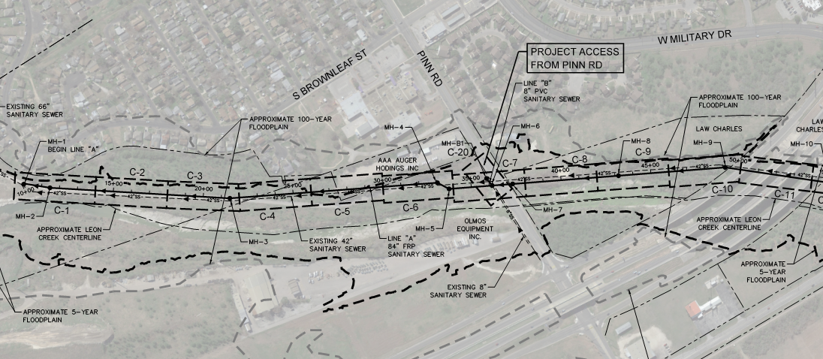
Project Access

Slide 42
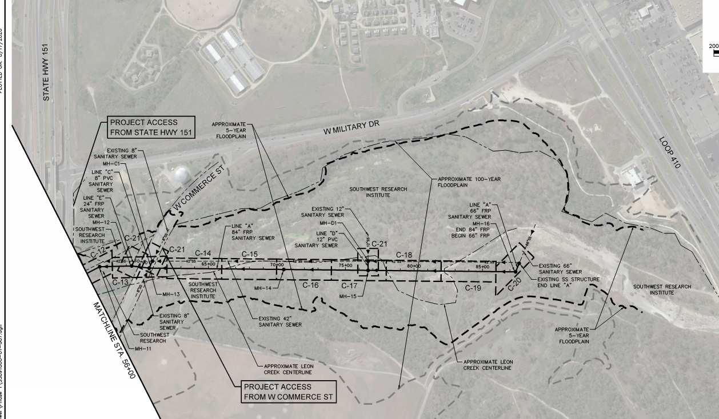
Project Access

Slide 43
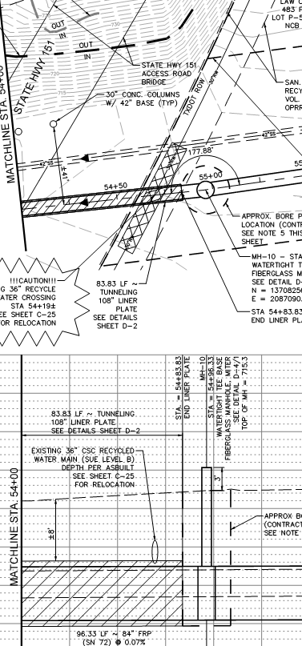
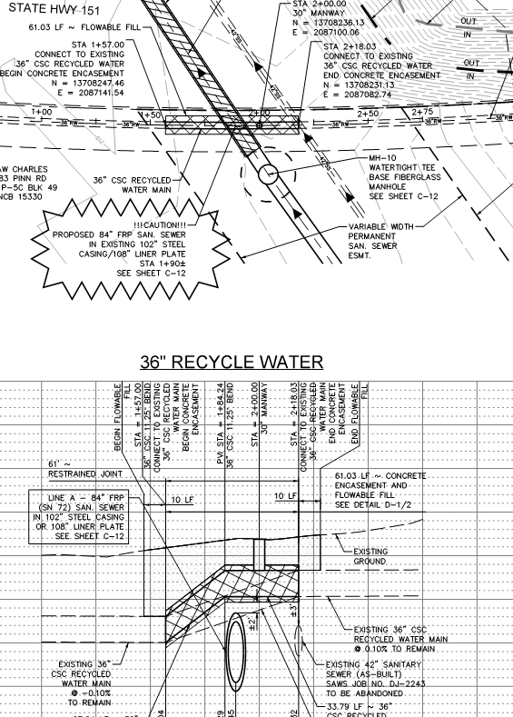
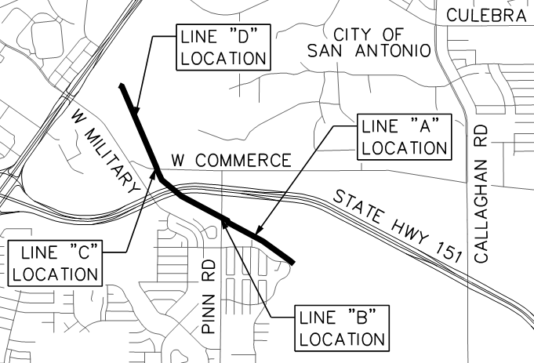
SAWS 36-inch CSC Recycled Water Main Relocation
30 day advanced notice required for shutdown.
Shutdown only during months November - March

Slide 44
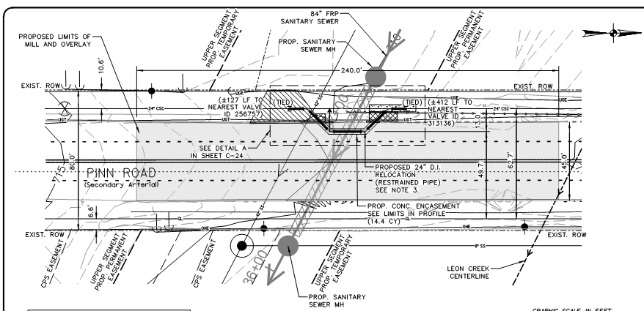
Pinn Road Water Main Relocation

Slide 45
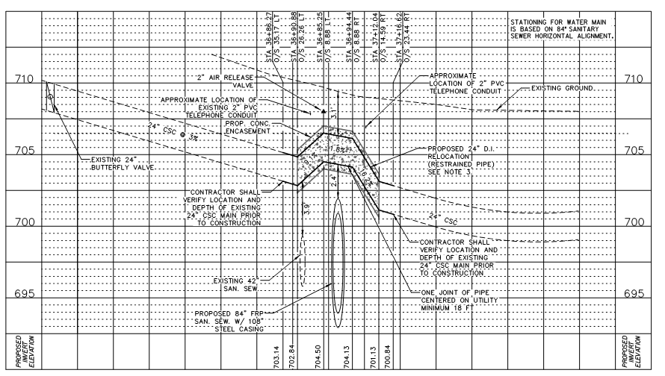
Pinn Road Water Main Relocation

Slide 46
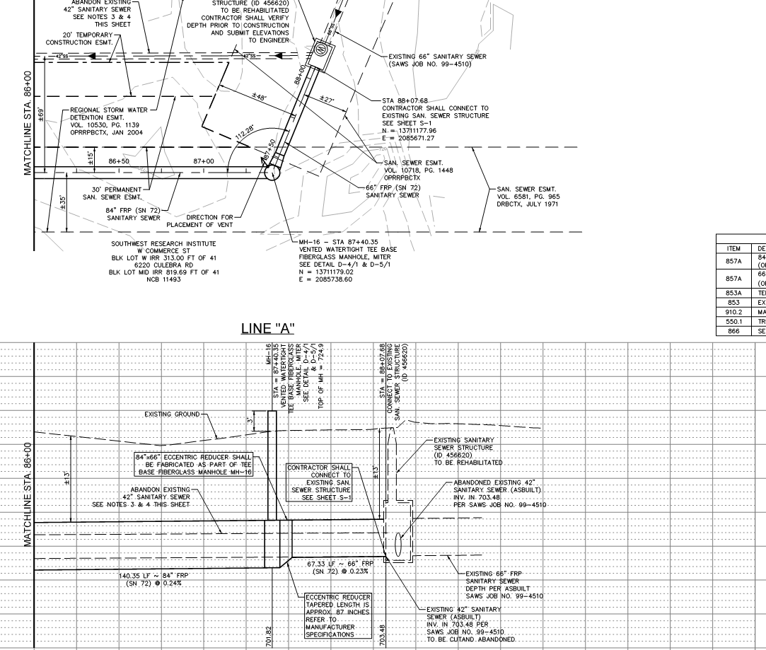
Upstream Tie-in Point

Slide 47
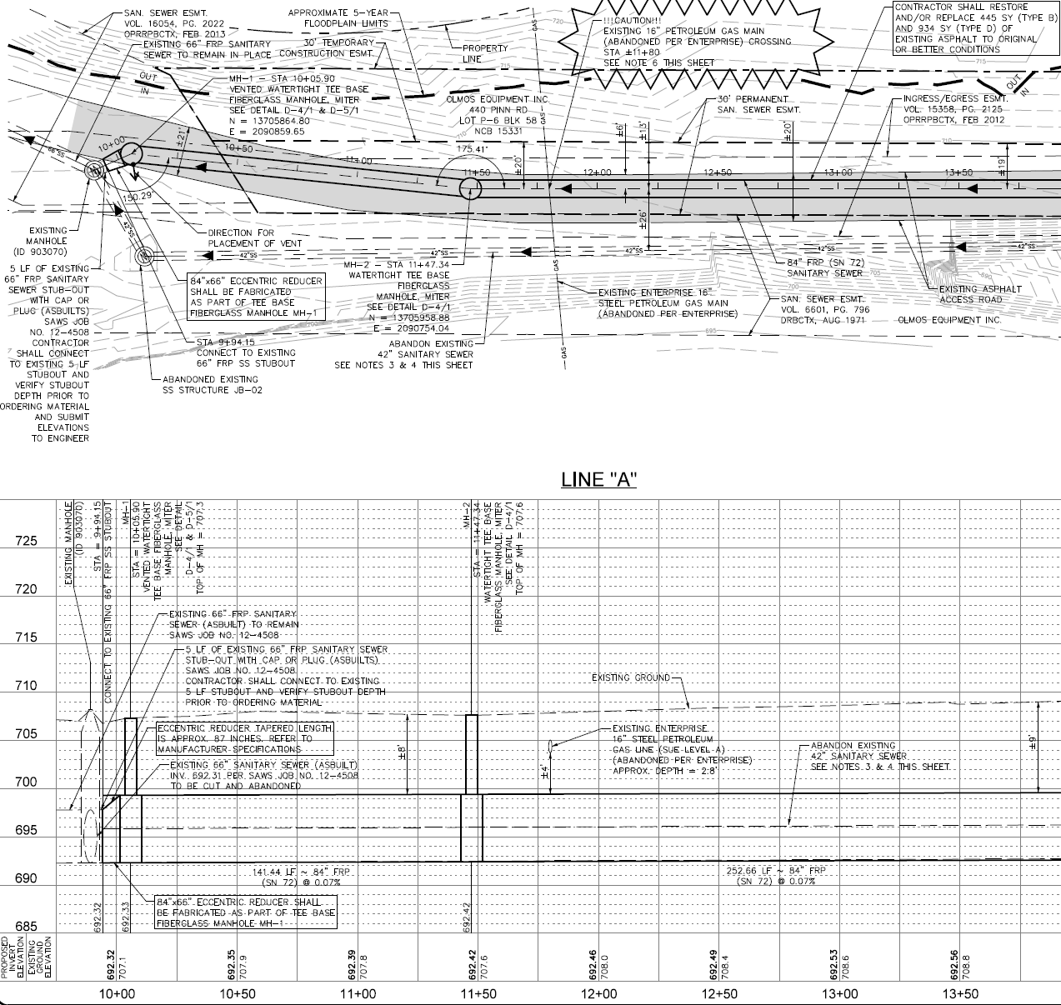
Downstream Tie-In Point

Slide 48
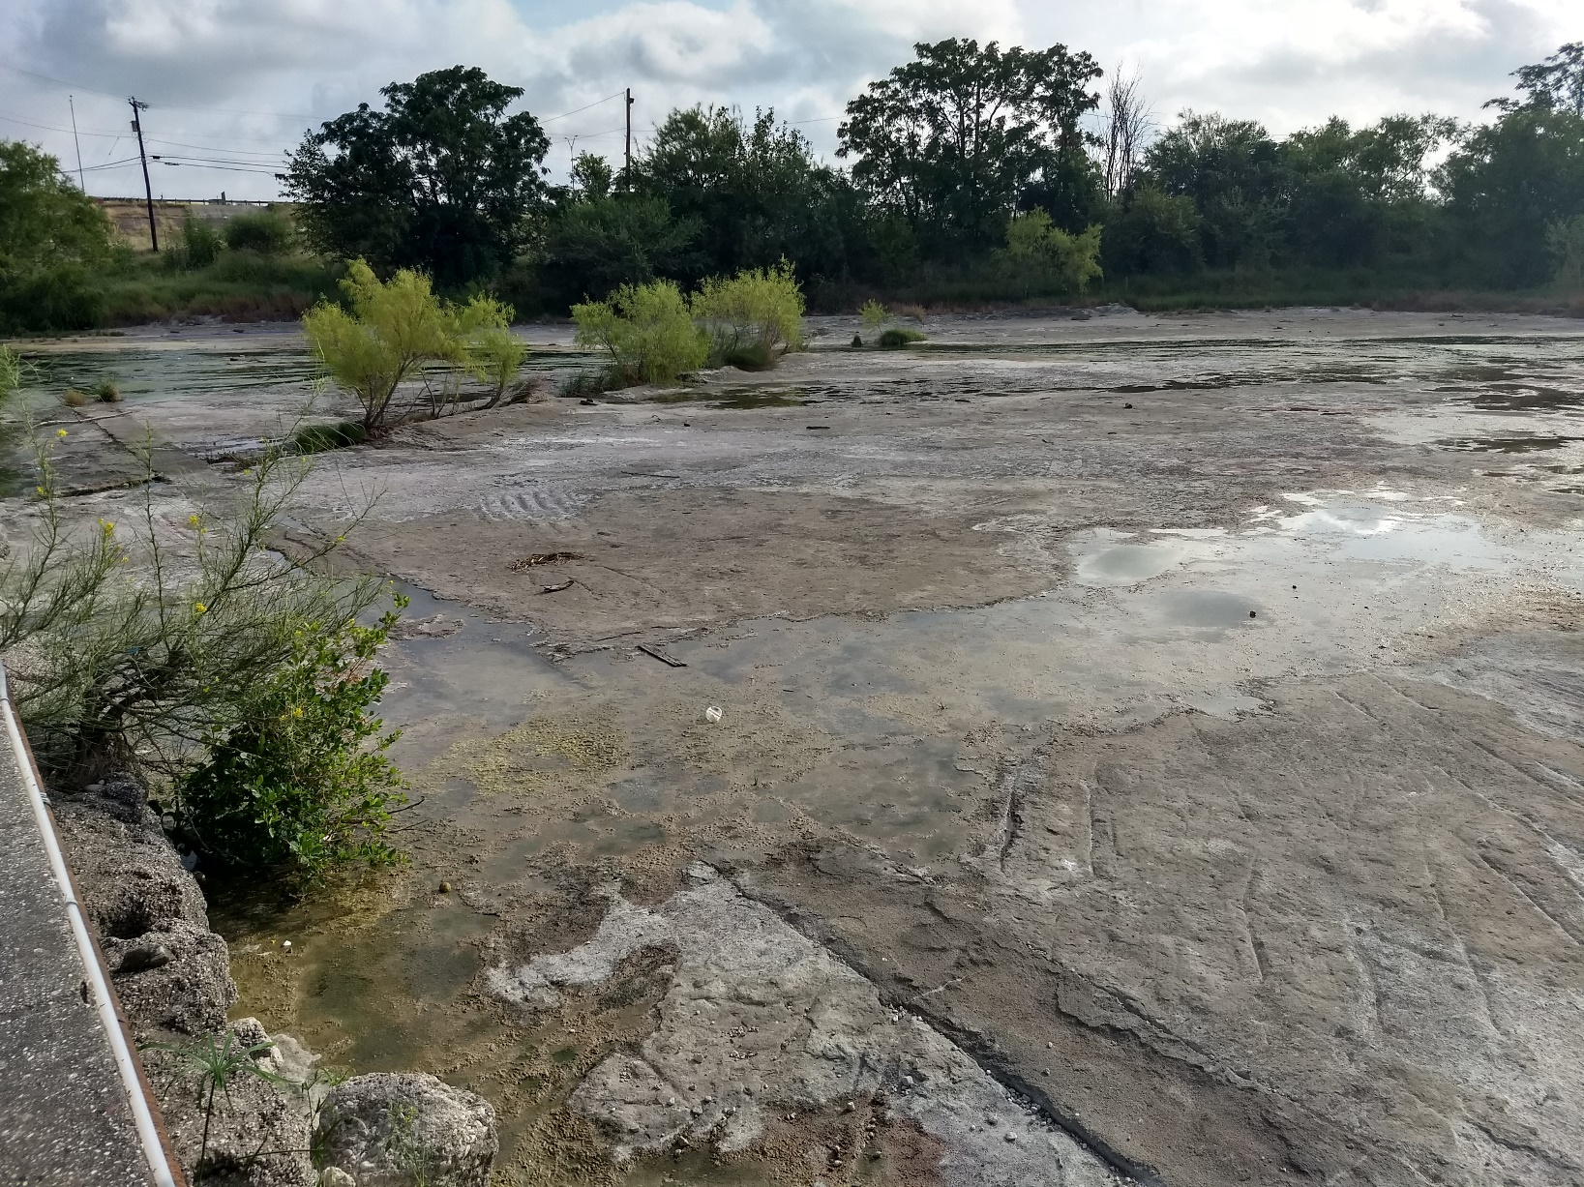
Ground and Surface Water Control
Refer to SS 2140 for Control of Ground and Surface Water
Responsible for submitting a Groundwater and Surface Water Control Plan prior to installation of dewatering systems

Slide 49

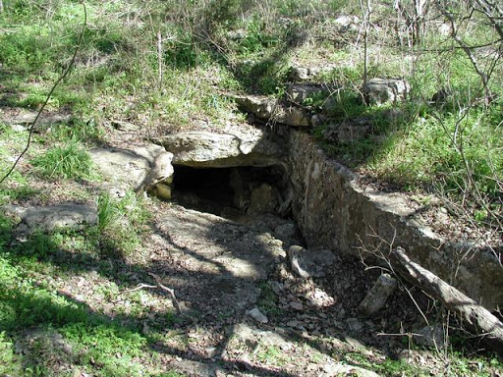
Special Conditions – Karst Species
Contractor shall have a qualified Biologist or Geologist monitor for Karst voids and Karst species during all excavation activities.
If Karst Features or Karst species are identified, construction in the area will stop and the USACE and the US Fish and Wildlife Service will be notified.
Contractor to refer to Special Conditions for Requirements.

Slide 50

Special Conditions - Migratory Birds
Refer to Special Conditions for Requirements
In accordance with the Migratory Bird Treaty Act (MBTA) Nesting Period (March-August)
Should construction and clearing occur from March through August, bird nest surveys need to be conducted by a biologist no more than 5 days prior to construction.

Slide 51
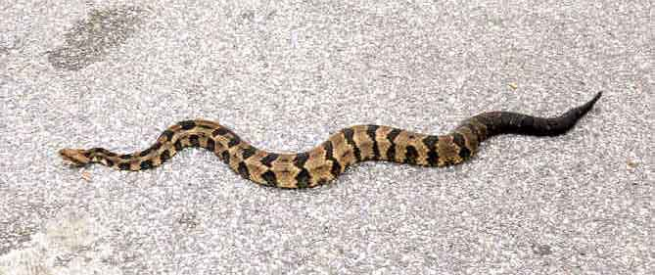
Special Conditions - Timber Rattlesnake
Refer to Special Conditions for requirements
Prior to construction Contractor personnel and Subcontractor attend training on:
  Snake Identification
  Handling
  Avoidance

Slide 52
Special Conditions – Rock Excavation
Refer to Special Conditions for requirements
Marl and Shale bedrock were encountered in our borings at relatively shallow depths.
The need for rock excavation equipment should be anticipated for construction at this site.
The additional cost for this work is incidental to pipe installation line items.

Slide 53
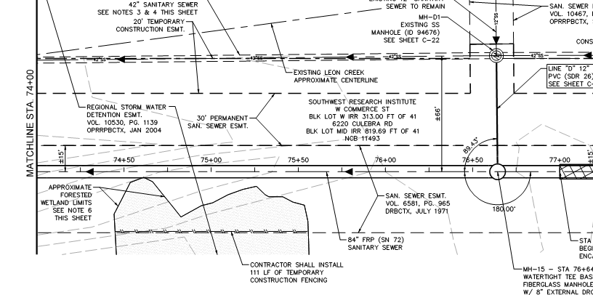
Forested Wetlands
In accordance with USACE Avoid Forested Wetland Area
Install Temporary Construction Fencing

Slide 54
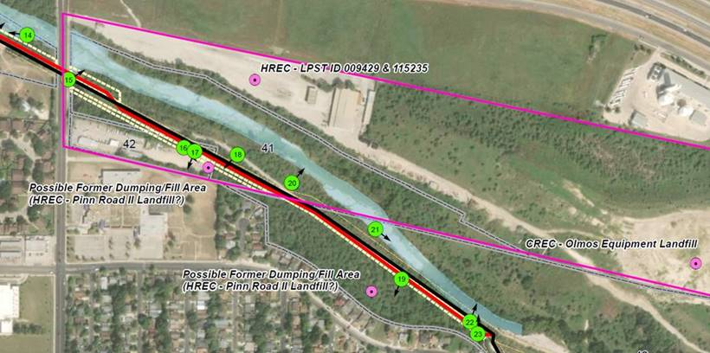
Former Dumping/Fill Areas
Allowance provided
Two Possible Former Dumping / Fill Areas
Refer to SS 804A for Contaminated Soil and Water Control
Pinn Rd.

Slide 55
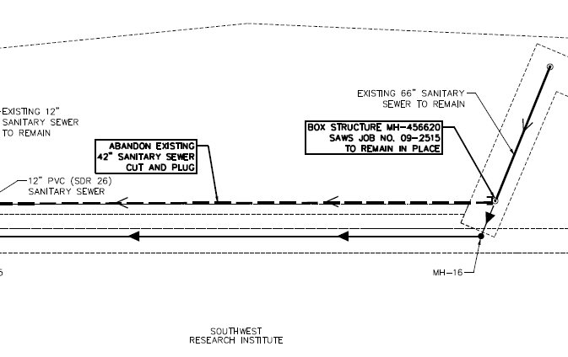
Sewer Abandonment
Abandon-in-place existing 42-inch sewer mains and manholes
All existing lines to be CCTV inspected prior to grouting
SPTS 862 indicates grouting of abandoned sewer lines and manholes shall be measured by the linear foot of abandoned sewer main

Slide 56
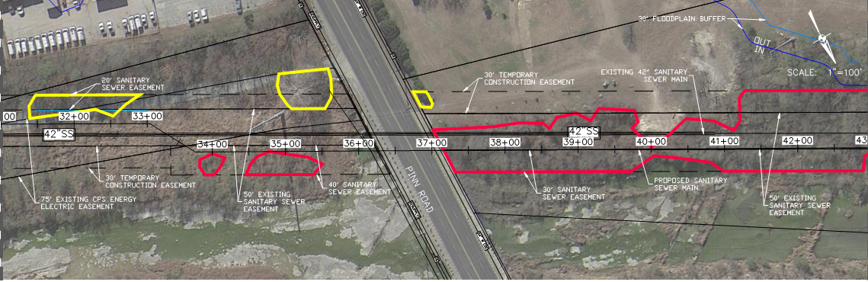
Tree Preservation Plans and Restoration
Pre-Construction walk-thru required with CoSA Arborist
Drill seeding with native mixture

Slide 57
Questions
Submitted no later than September 9, 2020 at 2:00 PM CDT
Identify solicitation number
Must be submitted in writing:
  Roxanne L. Lockhart
  Contract Administrator
  Contract Administration Department
  San Antonio Water System
  Roxanne.lockhart@saws.org
  Fax: (210) 233-4438

Slide 58
Questions?
Oral statements or discussion during the pre-proposal meeting will not be binding, nor will it change or affect the terms or conditions within the Plans and Specifications for this Project. Changes, if any, will be addressed only via an Addendum.

Slide 59
W-1 Leon Creek: Hwy 151 to Hwy 90
Upper Segment
Chris Mason, PE
Project Engineer, SAWS
Roxanne L. Lockhart
Contract Administrator, SAWS
Marisol V. Robles
SMWVP Program Manager, SAWS
Jason Diamond, PE
Project Engineer of Record, Pape-Dawson Engineers
Joseph Ortega, PE
Project Engineer, Pape-Dawson Engineers
Non-Mandatory Pre-Proposal Meeting
August 31, 2020 at 10:00 AM

